Slide 1
Music Player Using GUI
MINI PROJECT 2020-21

Slide 2
INTRODUCTION
Listening to music is a hobby of almost every person you meet around daily, for playing this music we need to have installed a music player in our device, each and every operating system whether it is Windows, Linux, Mac or even Android, Apple IOS also consist of a music player for playing your favorite songs.

Slide 3
OBJECTIVE
So In this Project, we will be learning how to create a music player from scratch using the Python Programming Language.
We will Use Python Gui Module Tkinter to create the Music Player
And will use Pygame Module For functioning of various song
Funcions.

Slide 4
Python Gui - Tkinter
Python offers multiple options for developing GUI (Graphical User Interface). Out of all the GUI methods, tkinter is the most commonly used method. It is a standard Python interface to the Tk GUI toolkit shipped with Python. Python with tkinter is the fastest and easiest way to create the GUI applications.
Tkinter is commonly bundled with Python, using Tk and is Python’s standard GUI framework. It is popular for its simplicity and graphical user interface. It is open source and available under the Python License.

Slide 5
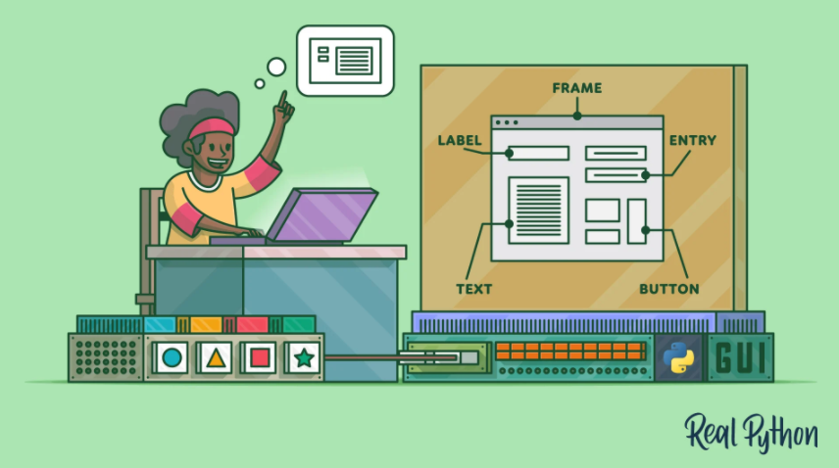
Tkinter Basic Working
Get started with Tkinter with a “Hello, World!” application
Work with widgets, such as buttons and text boxes
Control your application layout with geometry managers
Make your applications interactive by associating button clicks to Python functions

Slide 6
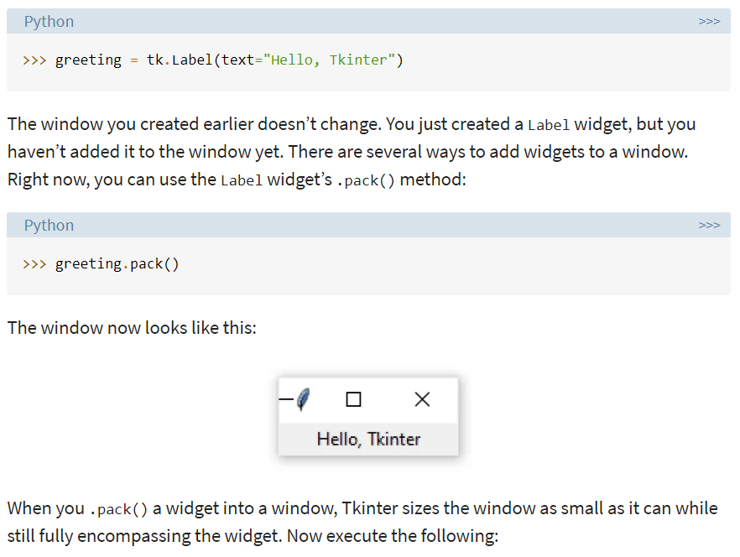
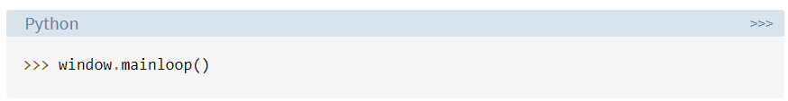
Adding A Widget

Slide 7

Pygame Module
Pygame is a Python module that works with computer graphics and sound libraries and designed with the power of playing with different multimedia formats like audio, video, etc. We will be using Pygame's mixer.music module for providing different functionality to our music player application that is usually related to the manipulation of the song tracks.

Slide 8
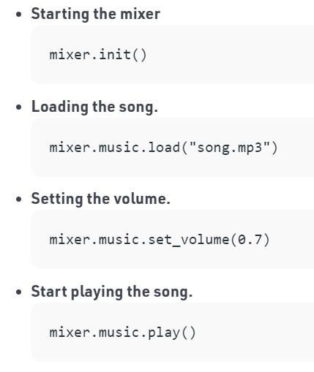
Pygame Functionalities

Slide 9
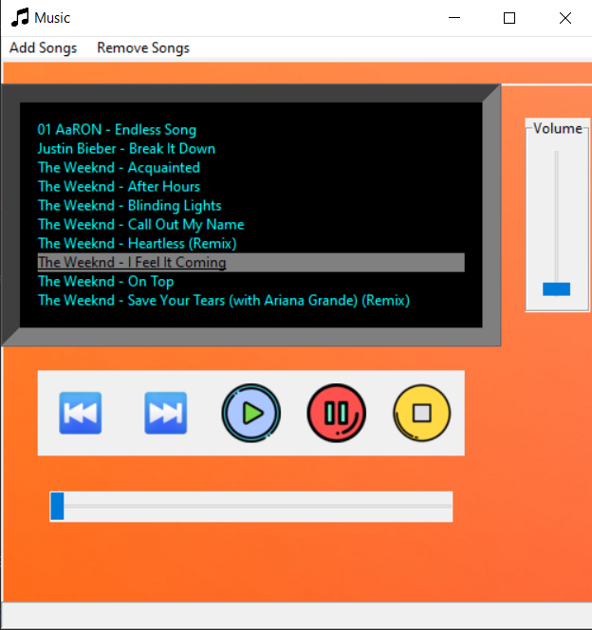
ScreenShot Of The Music Player

Slide 10
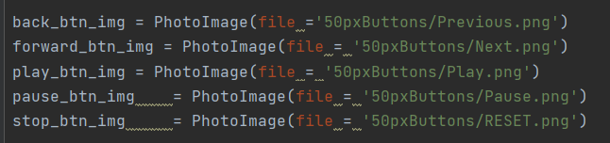
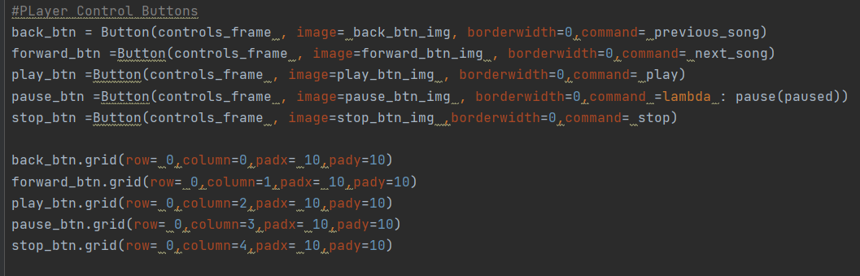
Creating Buttons

Slide 11
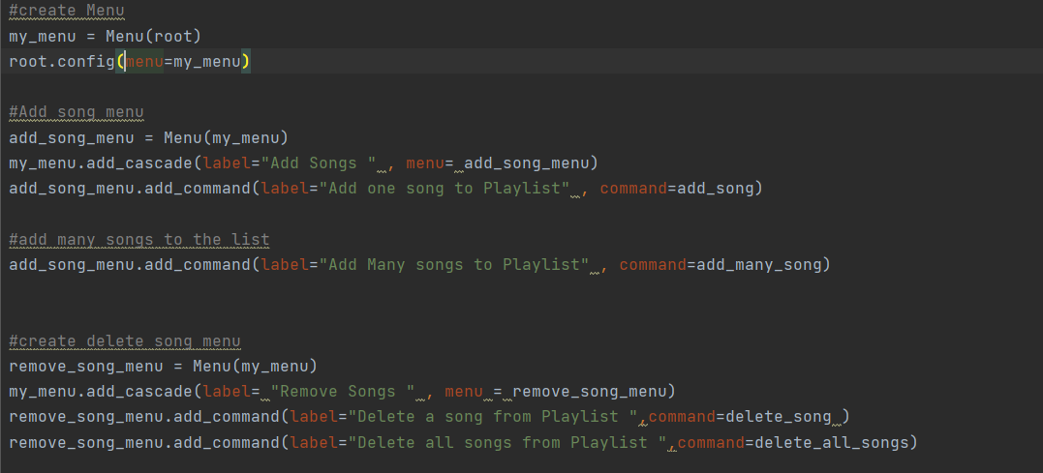
Creating Menus

Slide 12
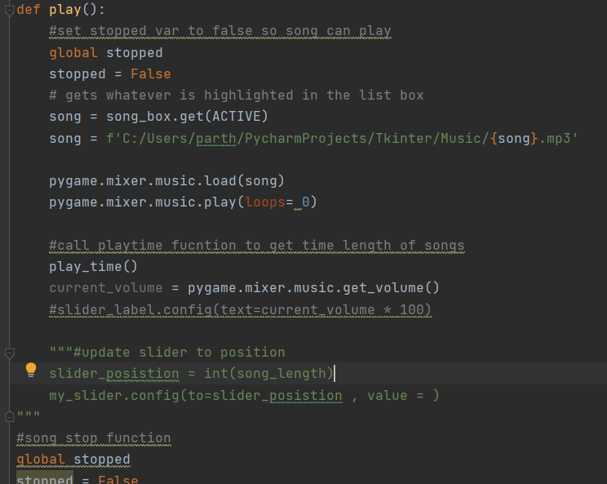
Play Fucntion

Slide 13
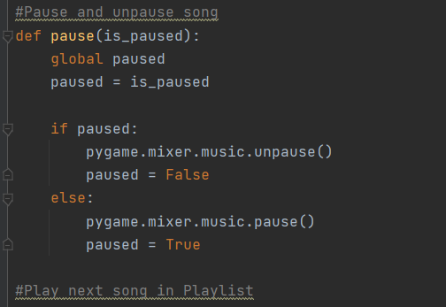
Pause Fucntion

Slide 14
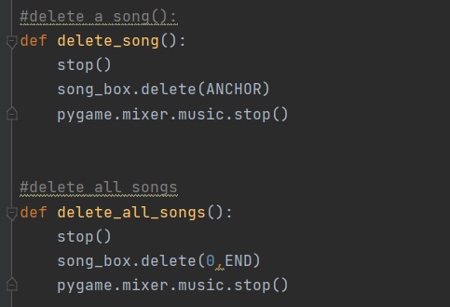
Deleting Songs from Playlist

Slide 15
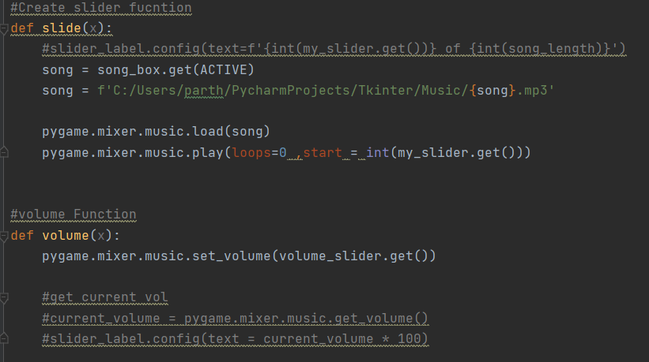
Song navigation and Volume Contols Using TTk module

Slide 16
CONCLUSION
In our Mini Project, we have implemented Python Gui – Tkinter Moule by building a working Music Player. The Music Player has certain basic features which is the necessities for a Music Player like Play,Pause,Reset,Volume Controls Etc. Tkinter provided a great way to create a computer application which is very responsive and can be updated with more new features.Using Pygame we Understood how to use effectively certain Python in-built fucntion along with some other Modules .

